Slide 1
SuperMarket Sales Dataset analysis
Group Member:
Omkar Shinde
Chinmay Shetye
Aakash Trivedi
Naga Karthik Potru

Slide 2
Introduction to dataset
The supermarket sales dataset consists of 1000 records detailing transactions across multiple branches and cities. It includes 17 columns, such as transaction identifiers (Invoice ID), customer demographics (Gender, Customer type), product details (Product line, Unit price, Quantity), and financial metrics (Total, Tax, Gross income, Cost of Goods Sold). The dataset also captures the transaction time, date, and payment method (e.g., Cash, E-wallet). Additionally, it features customer feedback through a Rating column. The data is complete with no missing values, providing a rich mix of categorical and numerical attributes suitable for various analyses, such as customer behavior insights, sales trends, and profitability evaluation.

Slide 3
ABSTRACT
a dataset containing 1000 transactions from a multi-branch supermarket, offering a detailed view of operational and financial dynamics. With attributes such as customer demographics, product categories, transaction timing, payment methods, and customer ratings, the dataset provides a foundation for analyzing consumer behavior and sales performance. Additionally, key financial indicators like unit price, tax, and gross income enable an evaluation of profitability and operational efficiency. Through exploratory data analysis and visual storytelling, the presentation aims to highlight patterns, uncover actionable insights, and propose strategies for enhancing business outcomes.

Slide 4
DATASET Details
Invoice ID: Unique identifier for each transaction.
Branch: Branch of the supermarket (e.g., A, B, C).
City: City where the transaction occurred (e.g., Yangon, Naypyitaw).
Customer type: Type of customer (e.g., Member, Normal).
Gender: Gender of the customer (Male or Female).
Product line: Category of products sold (e.g., Health and Beauty, Electronics).
Unit price: Price per unit of the product.
Quantity: Number of units purchased.
Tax 5%: Tax amount applied (5%).
Total: Total cost of the transaction (including tax).
Date: Date of the transaction.
Time: Time of the transaction.
Payment: Payment method (e.g., Cash, E-wallet, Credit Card).
cogs: Cost of goods sold.
Gross margin percentage: Margin percentage (constant at 4.761905%).
Gross income: Income generated from the transaction.
Rating: Customer rating for the transaction.

Slide 5
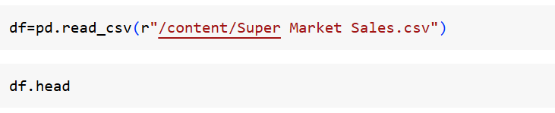
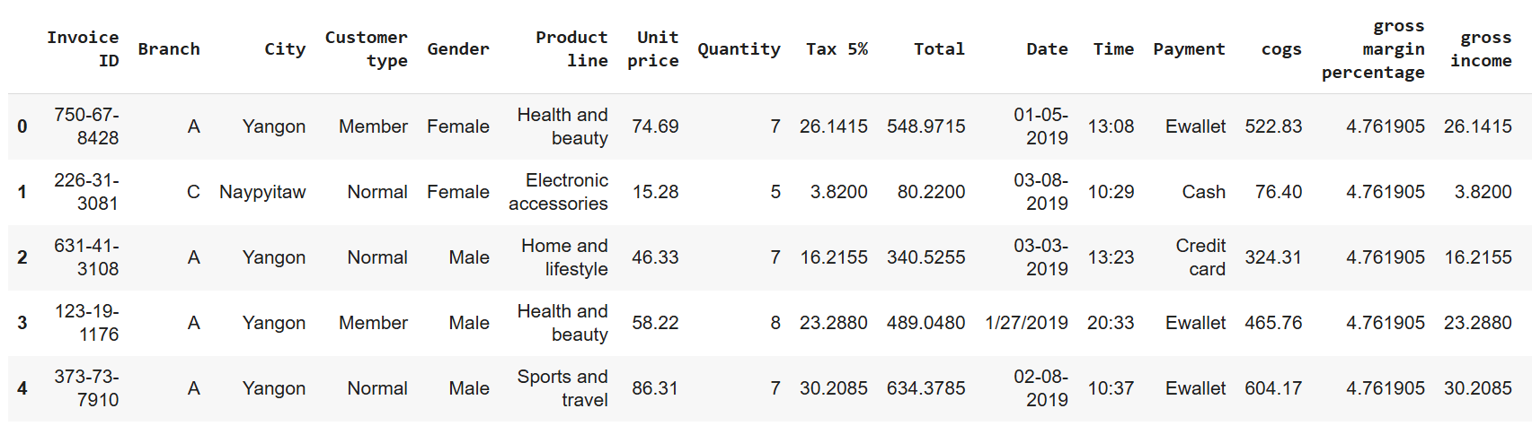
DATA loading

Slide 6
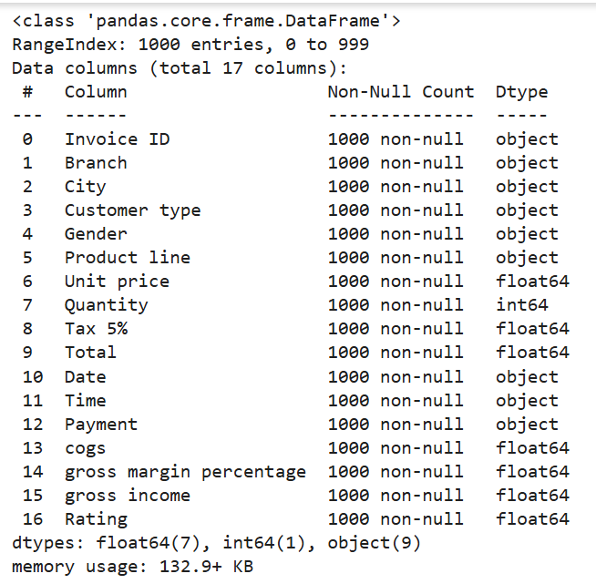
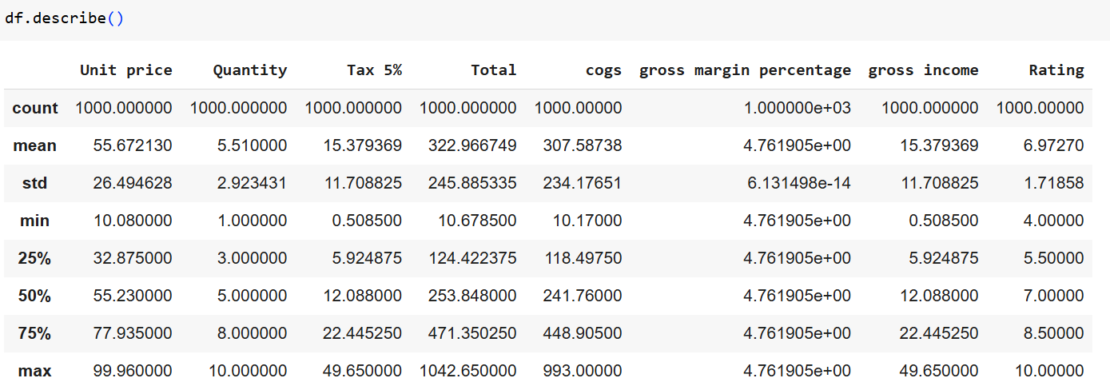
DATA INTERPRETATION

Slide 7
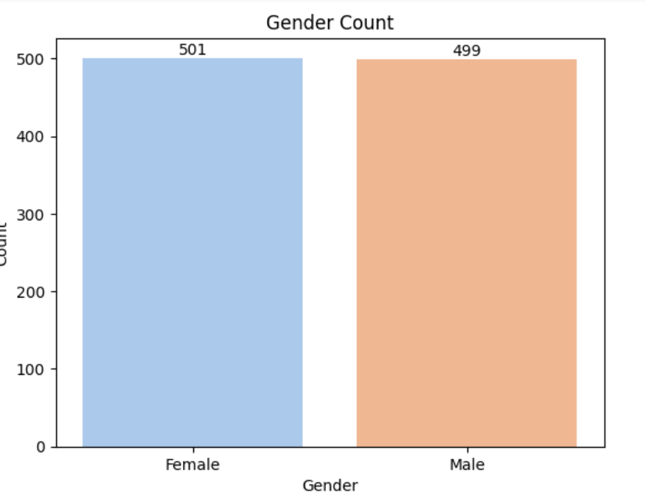
Gender Distribution of Customers

Slide 8
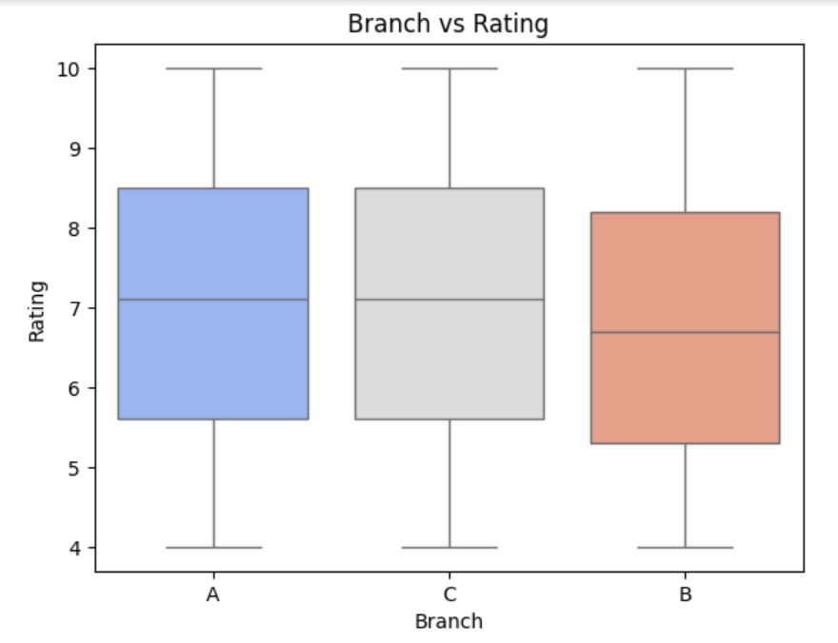
BOXPLOTTING

Slide 9
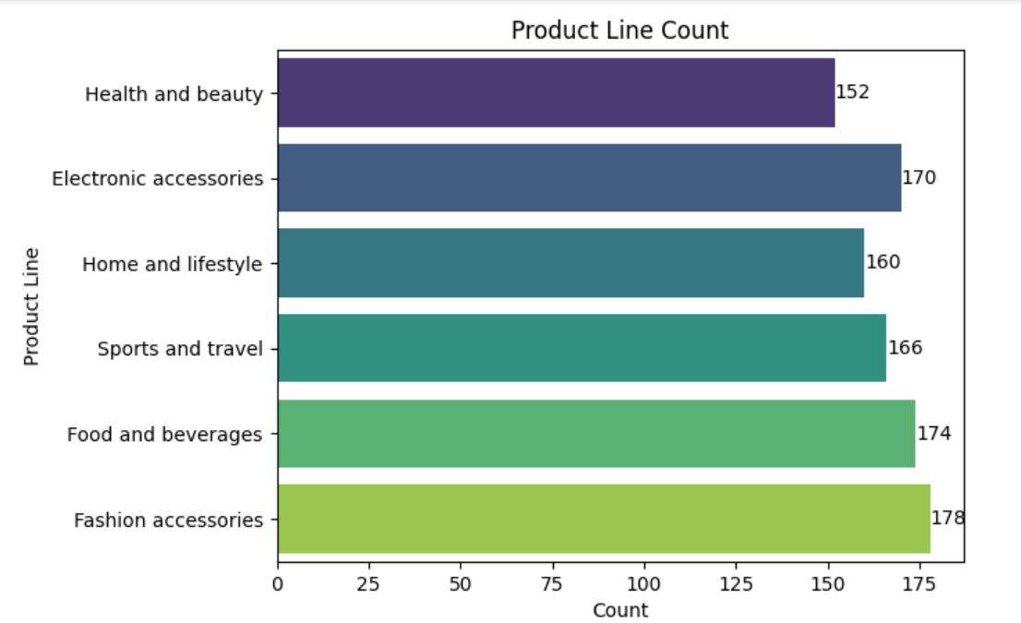
Analysis of Product Line Performance

Slide 10
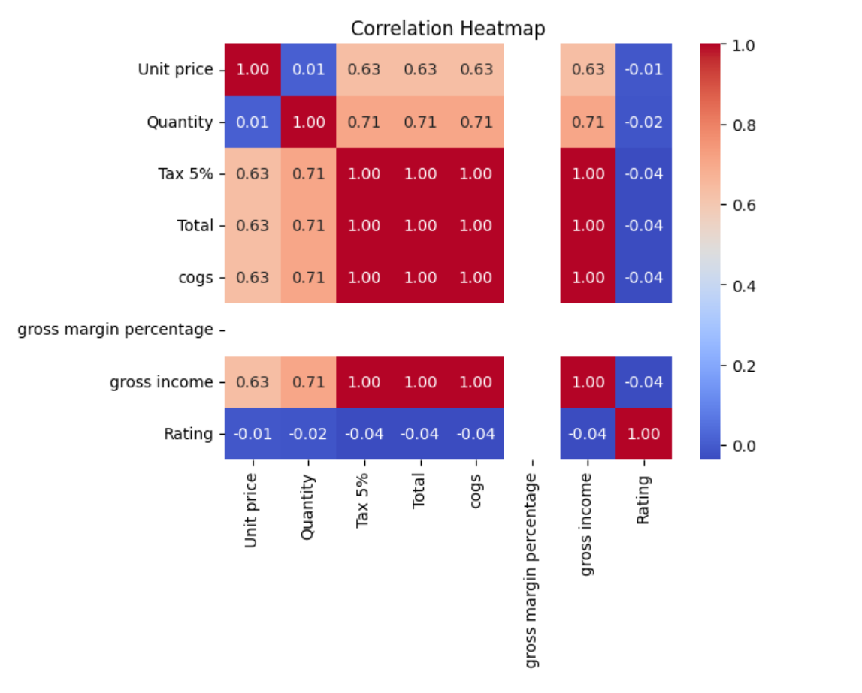
Correlation Analysis of Key Variables

Slide 11
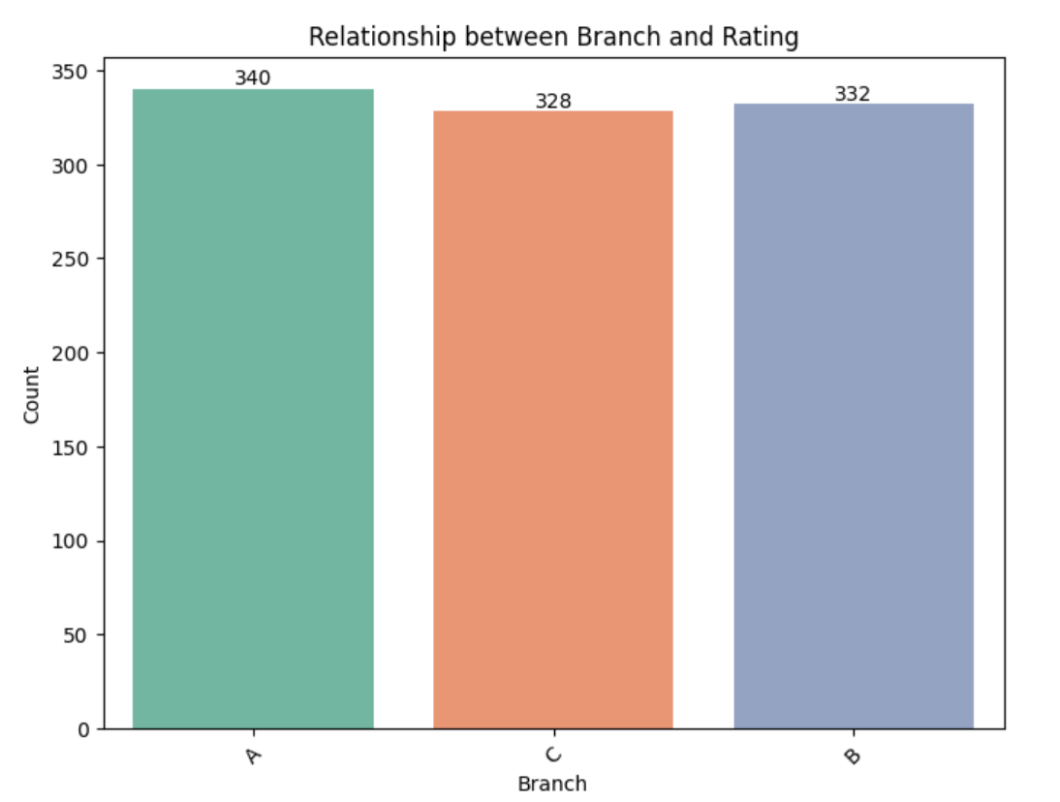
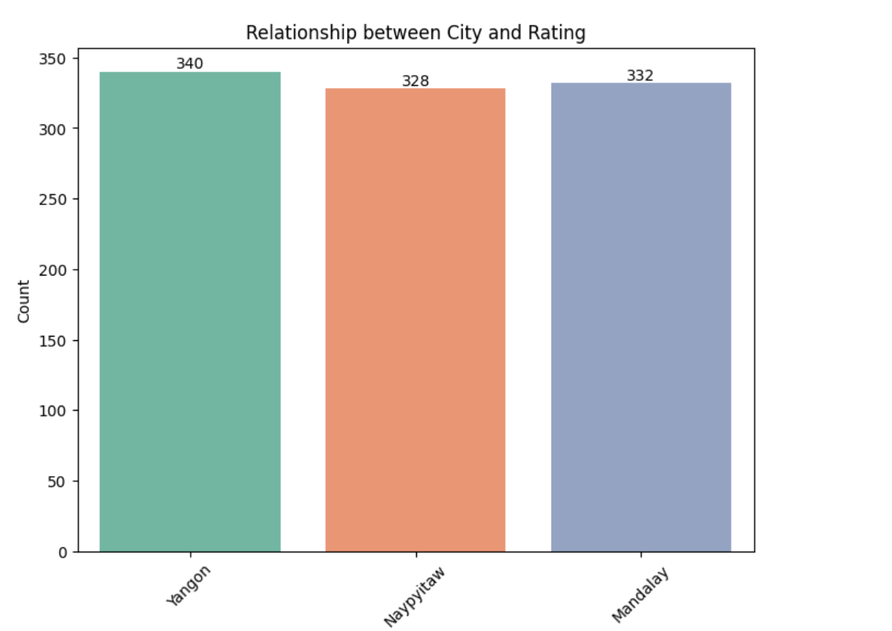
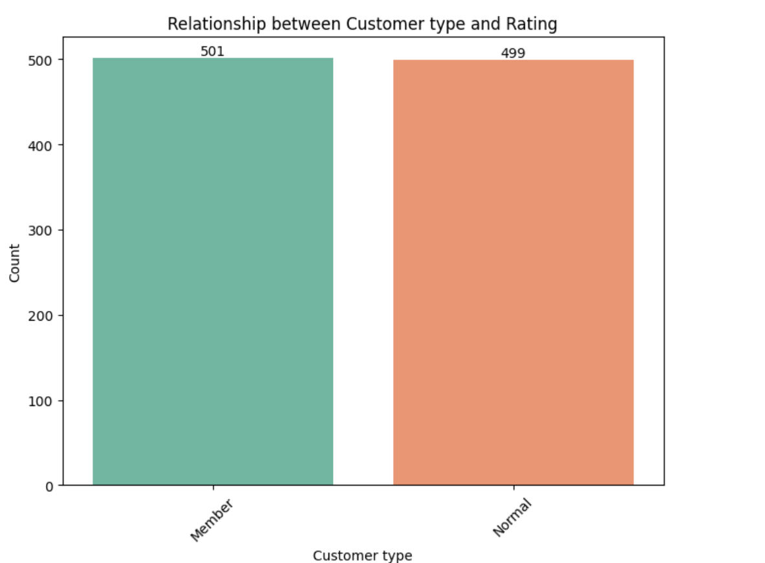
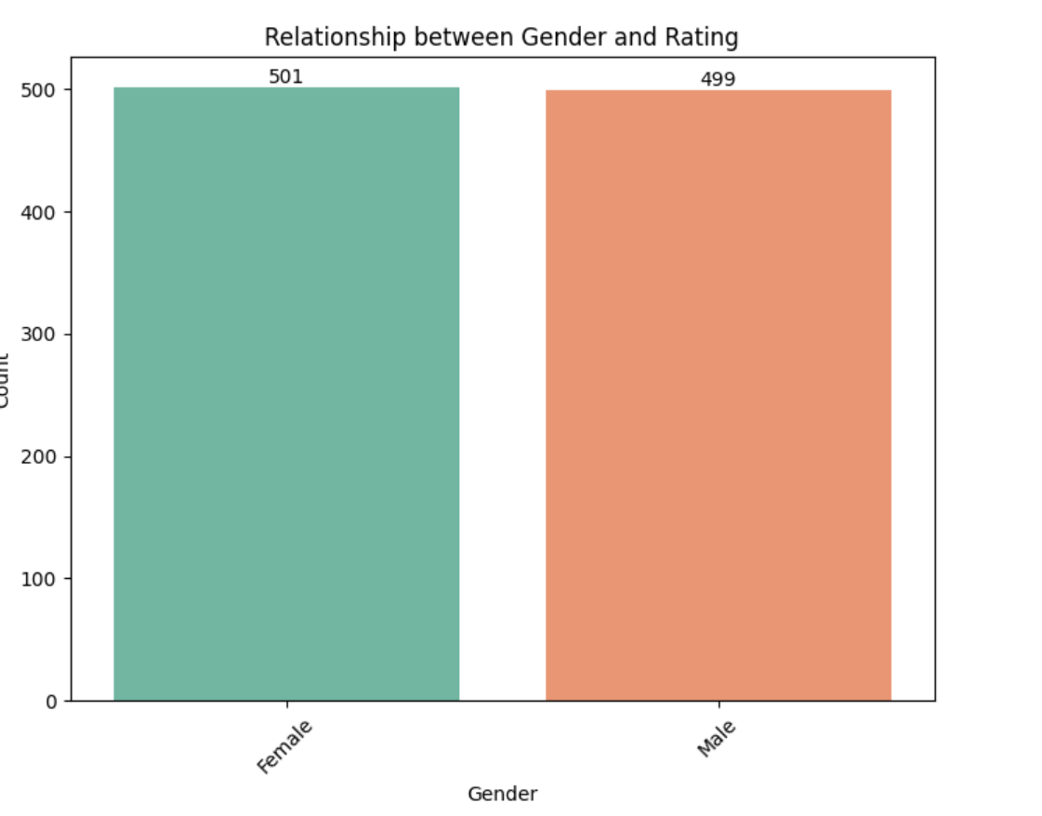
Exploring Relationships Between Customer Demographics and Ratings

Slide 12
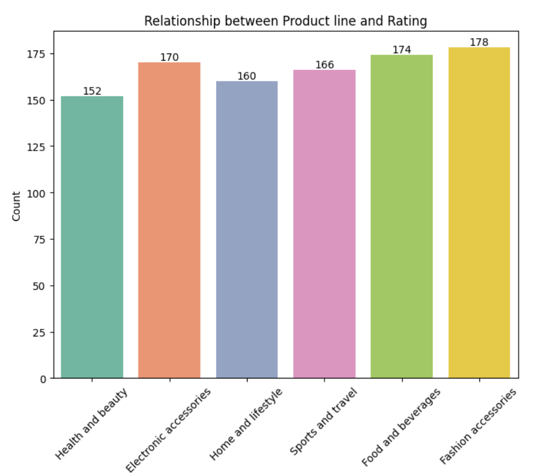
Customer Ratings by Product Line

Slide 13
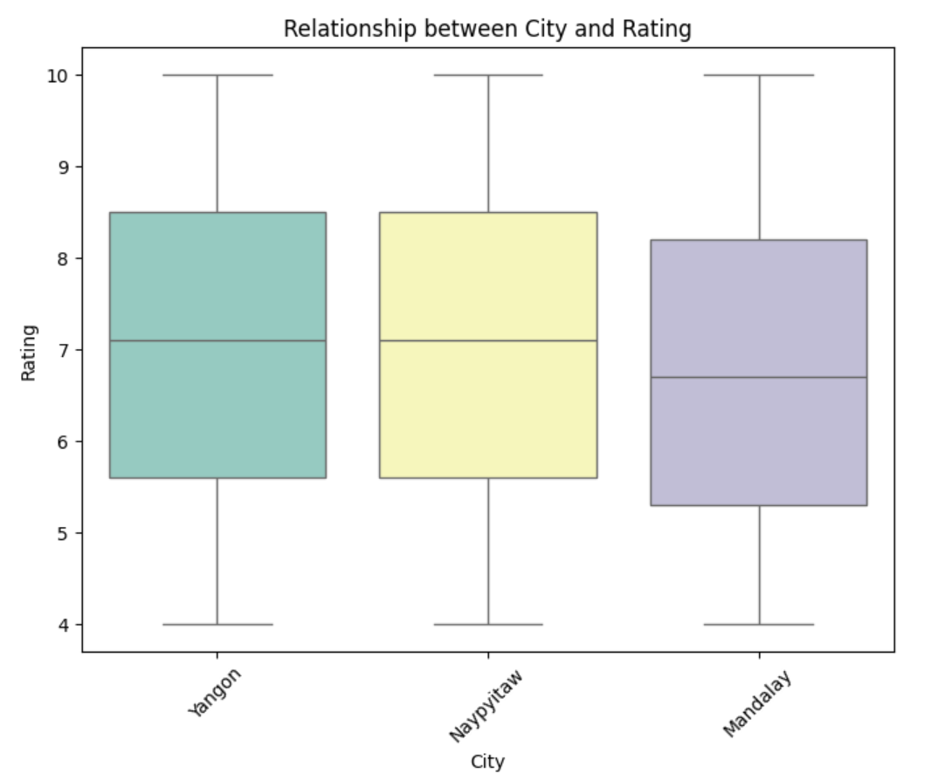
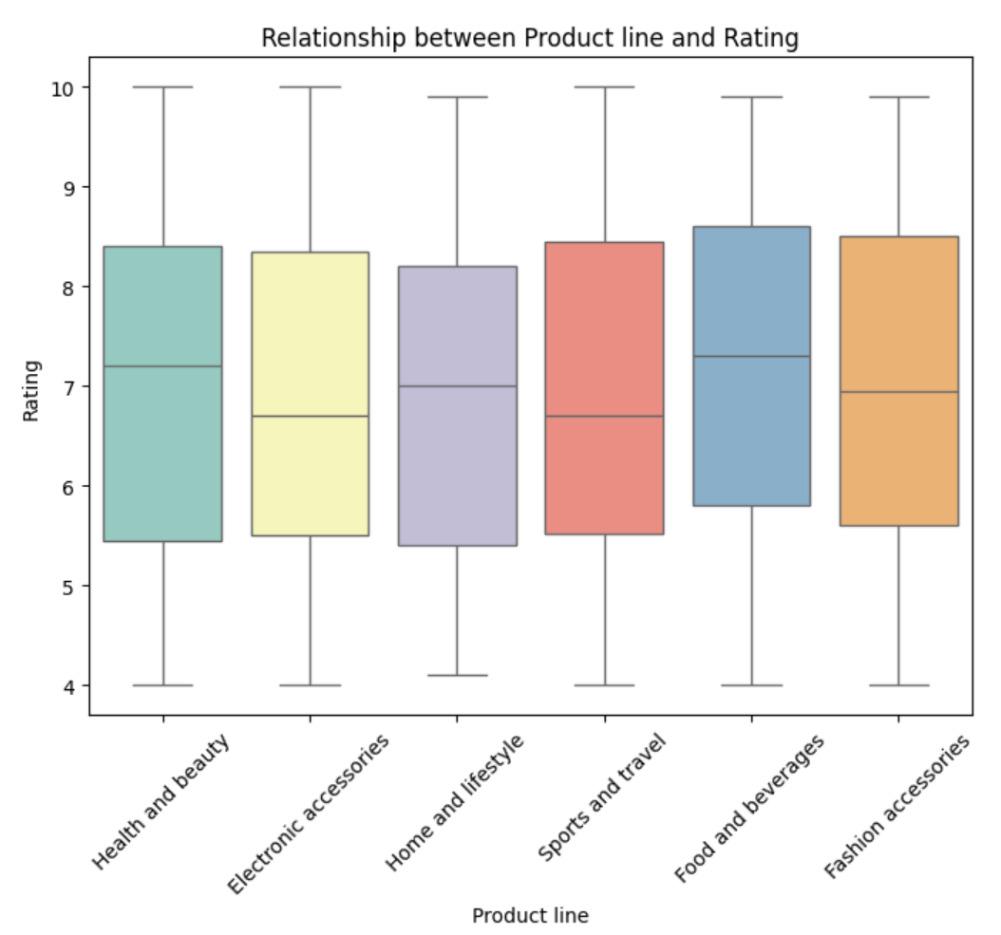
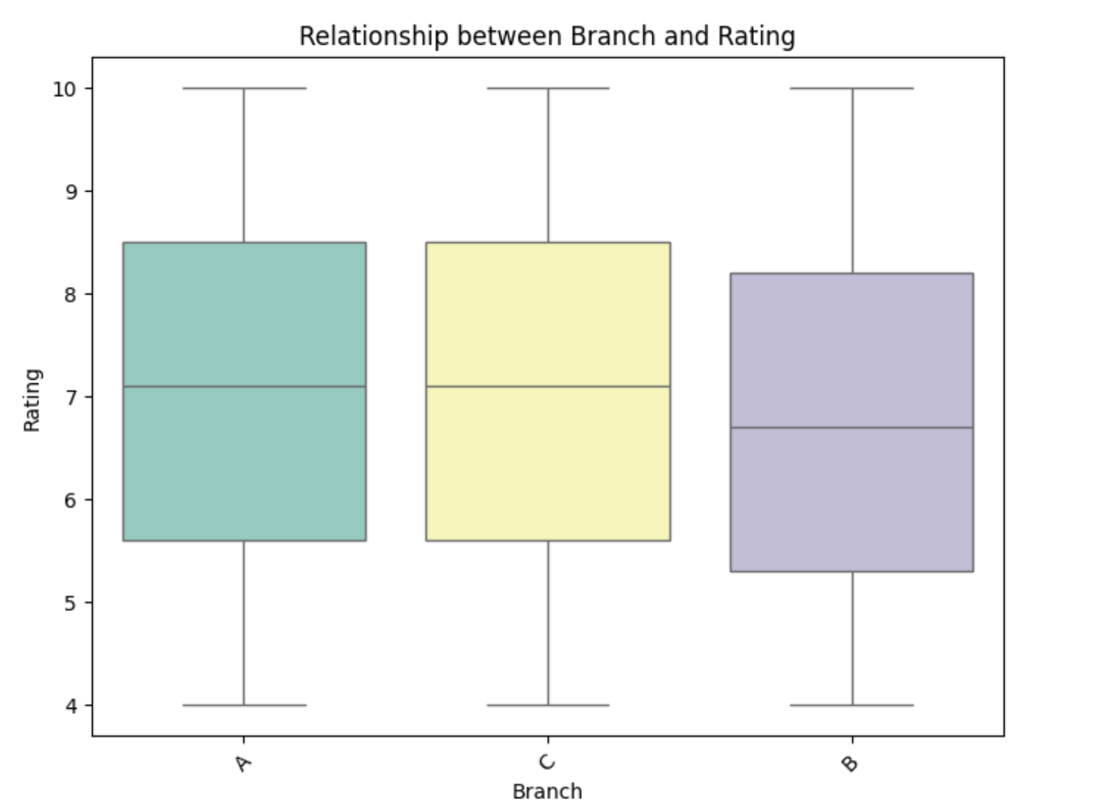
Analyzing Customer Ratings Based on Key Attributes

Slide 14
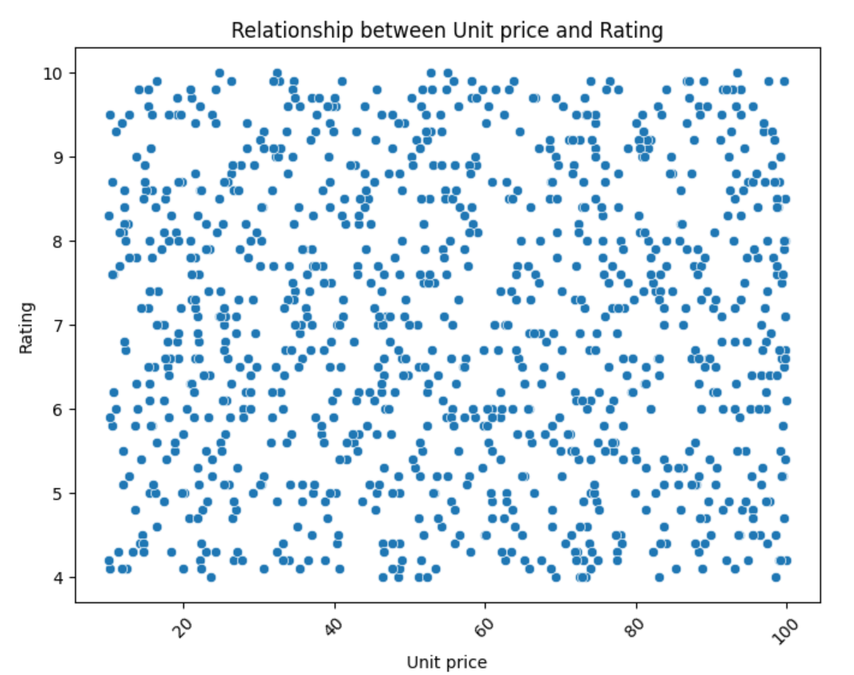
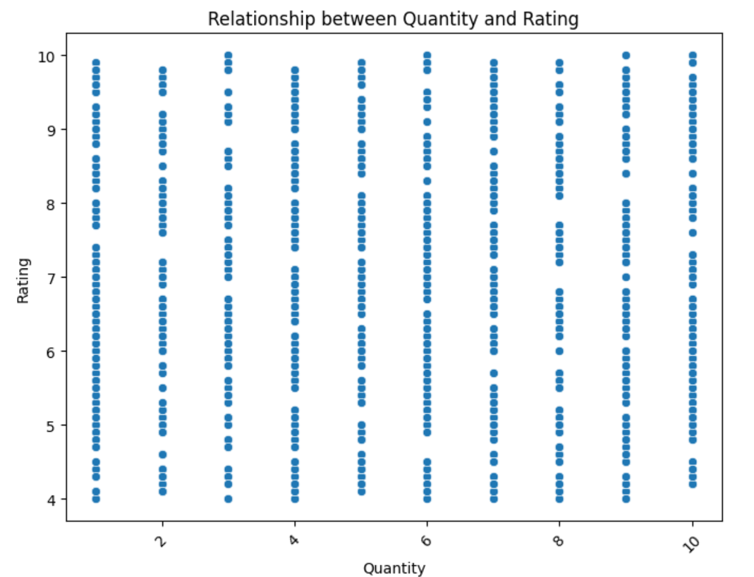
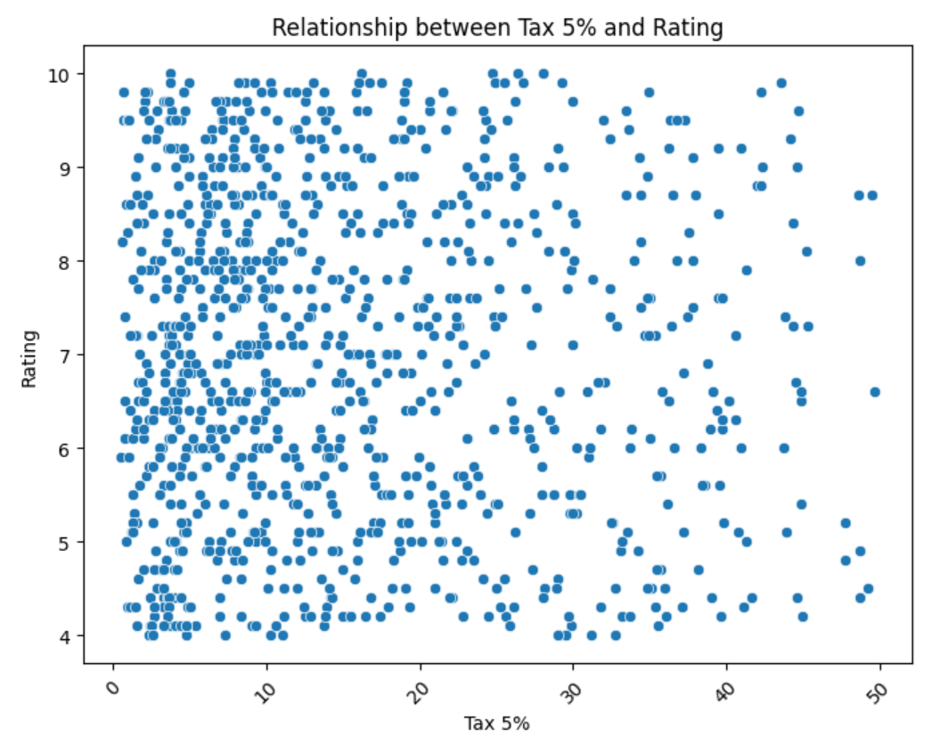
Analyzing the Impact of Key Variables on Customer Ratings

Slide 15
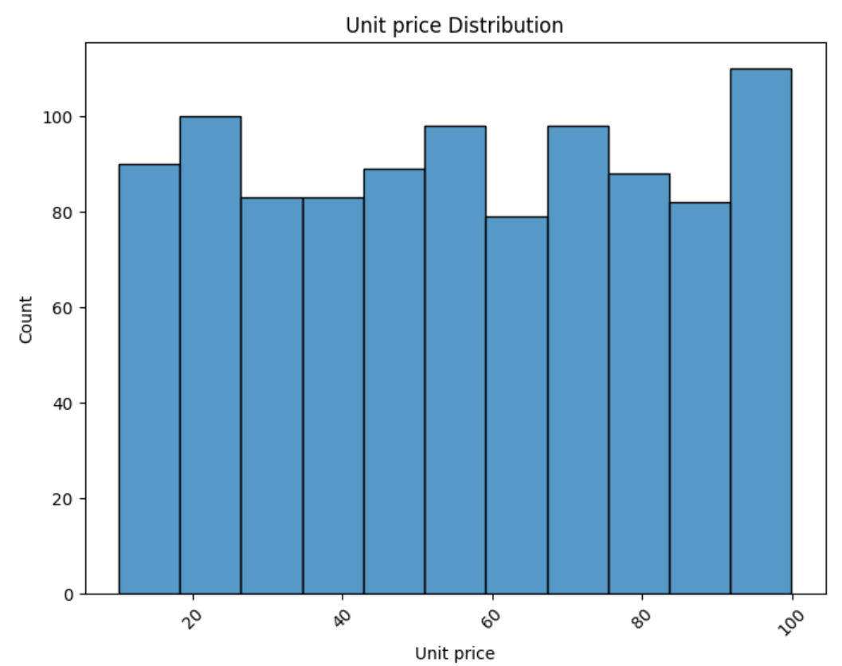
Unit Price Distribution Analysis

Slide 16
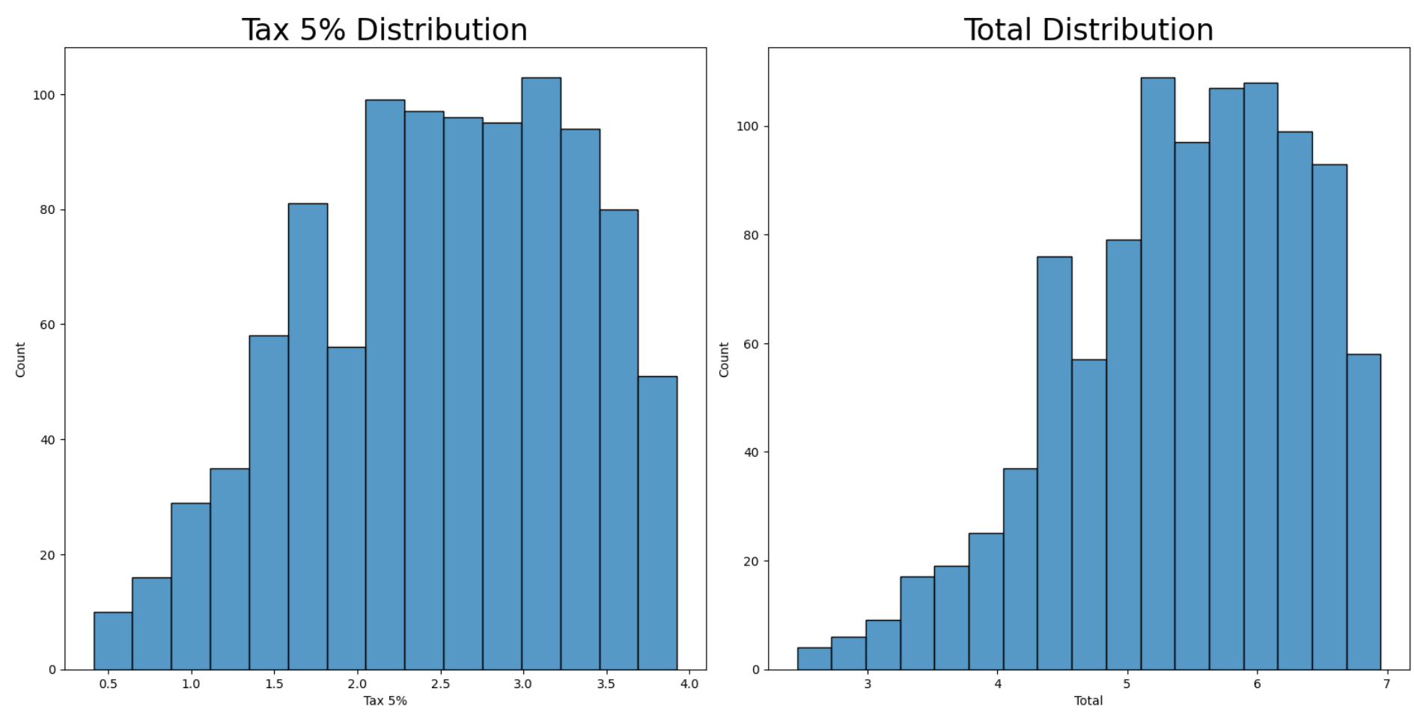
Tax and Total Amount Distribution Analysis with Log Transformation

Slide 17
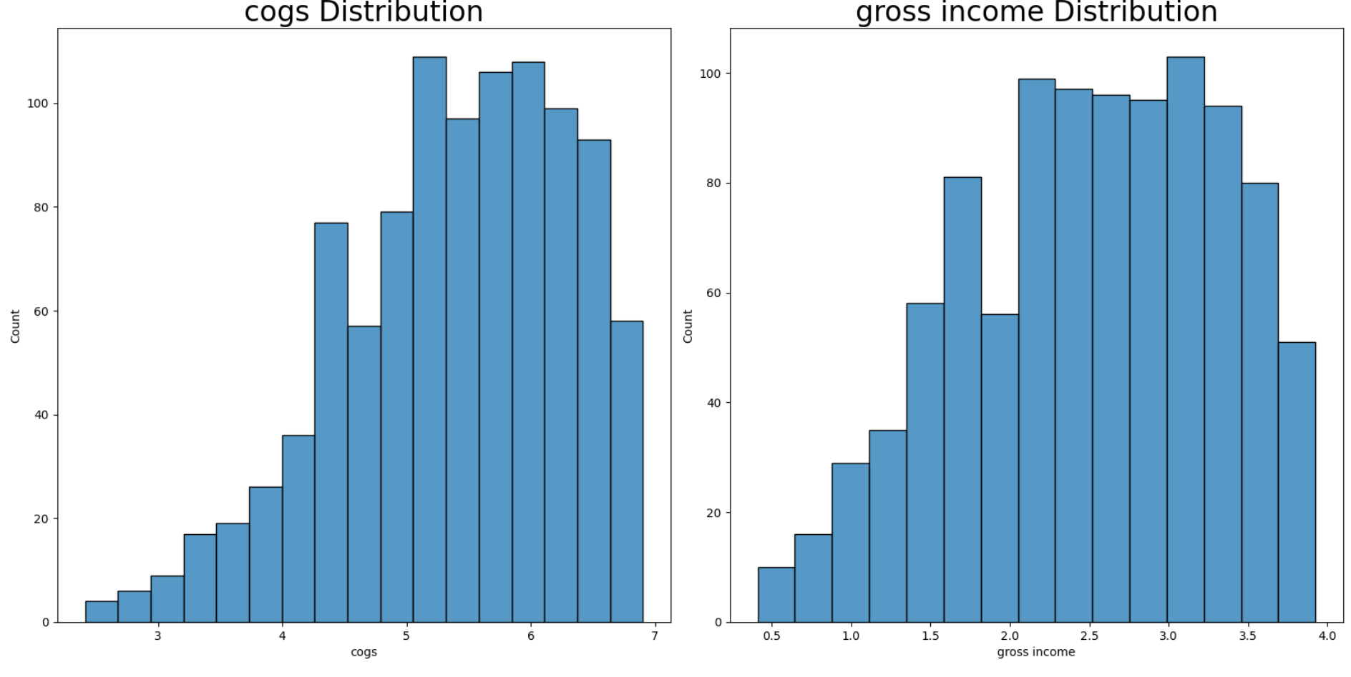

Slide 18
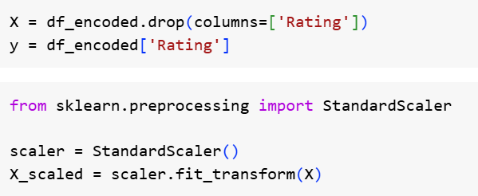
Data Preparation and Train-Test Split for Predictive Modeling

Slide 19
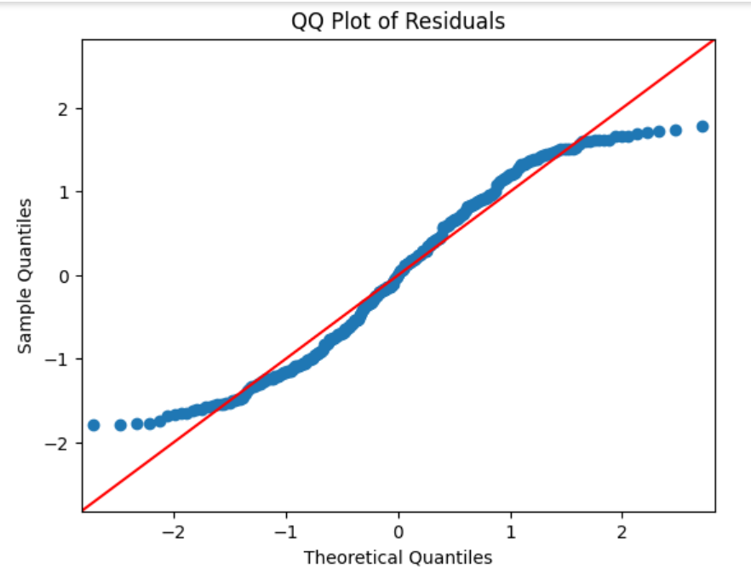
QQ Plot of Residuals

Slide 20

Root Mean Squared Error

Slide 21
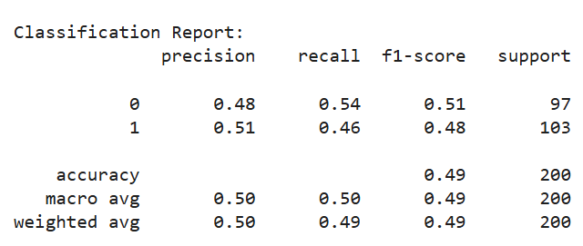
Logistics regression

Slide 22
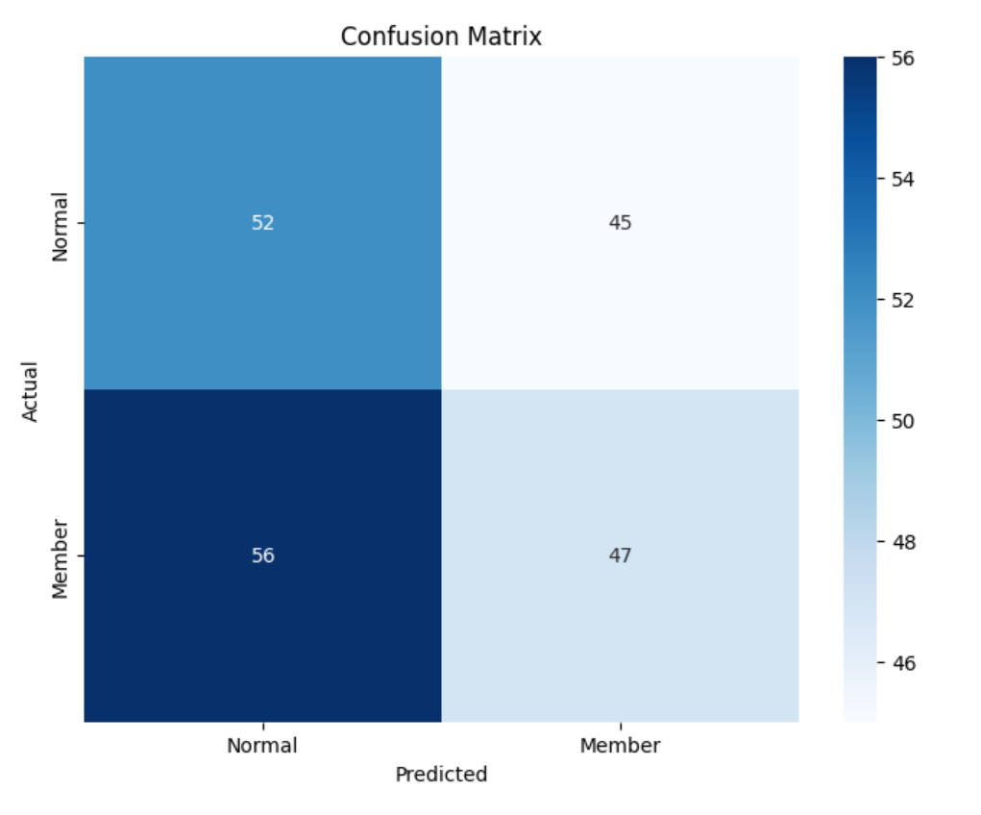
Confusion Matrix for Logistic regression

Slide 23
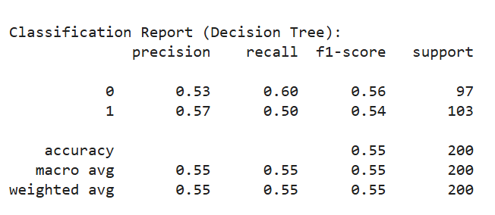
DECISION TREE

Slide 24
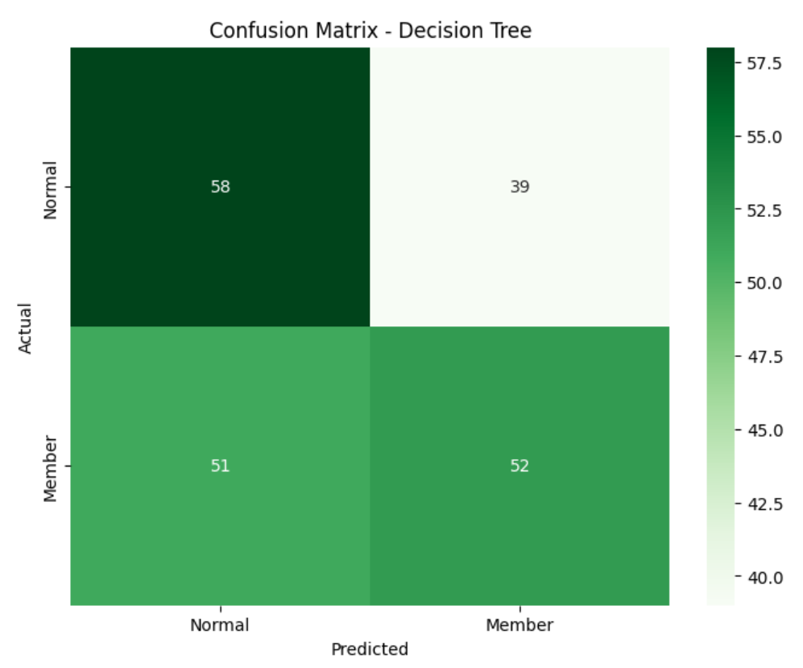
Confusion Matrix for Decision Tree

Slide 25
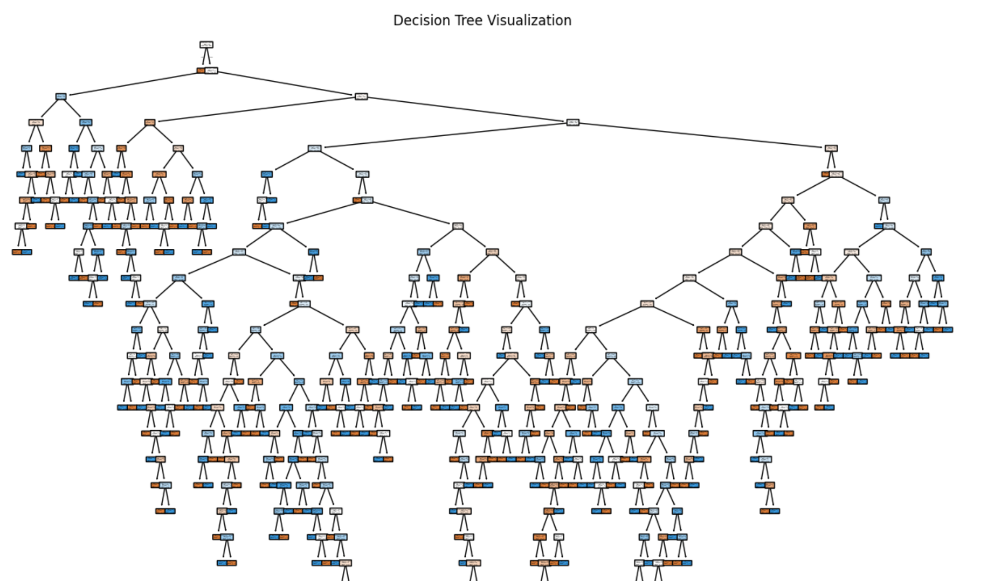
Decision Tree Visualization for Customer Classification

Slide 26
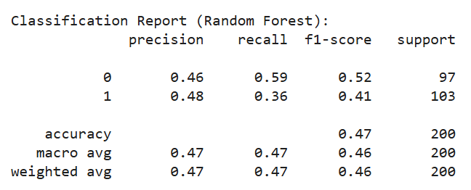
Random forest

Slide 27
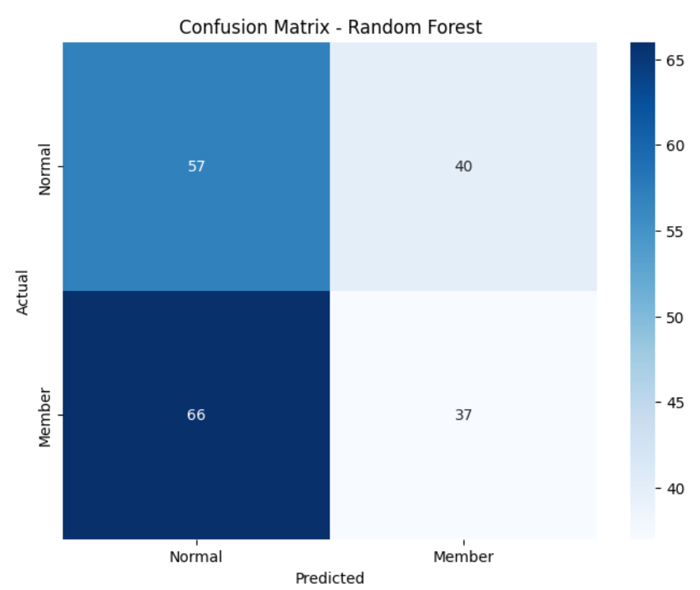
Confusion Matrix for Random Forest Classification

Slide 28
Challenges and limitation
The dataset includes transactions for a specific period, which may not capture seasonal trends or year-round variations in sales and customer behavior.
It provides basic demographics like gender and customer type but lacks deeper insights into customer profiles, such as age, income, or loyalty history, that could enhance the analysis.
The gross margin percentage is constant at 4.761905%, limiting the study of variations in profitability across different products or transaction types.
It is confined to three cities (Yangon, Naypyitaw, Mandalay), potentially restricting its applicability to other regions or broader markets.
While the product line is specified, there is no granular information about individual products, brands, or inventory, which limits detailed product-specific analysis.
Although the dataset includes dates and times, it does not span multiple years, making it difficult to identify long-term trends or shifts in consumer behavior.

Slide 29
CONCLUSION
the supermarket sales dataset provides valuable insights into transaction patterns, customer preferences, and financial performance across multiple branches and cities. Its clean structure and comprehensive coverage of key variables make it suitable for analyzing sales trends, customer behavior, and profitability. However, certain limitations, such as the lack of detailed customer information, geographic and temporal constraints, and the absence of promotional or operational data, highlight opportunities for further enrichment. Despite these challenges, the dataset serves as a robust foundation for driving data-driven decision-making and identifying actionable strategies to enhance business outcomes.

